Slide 1




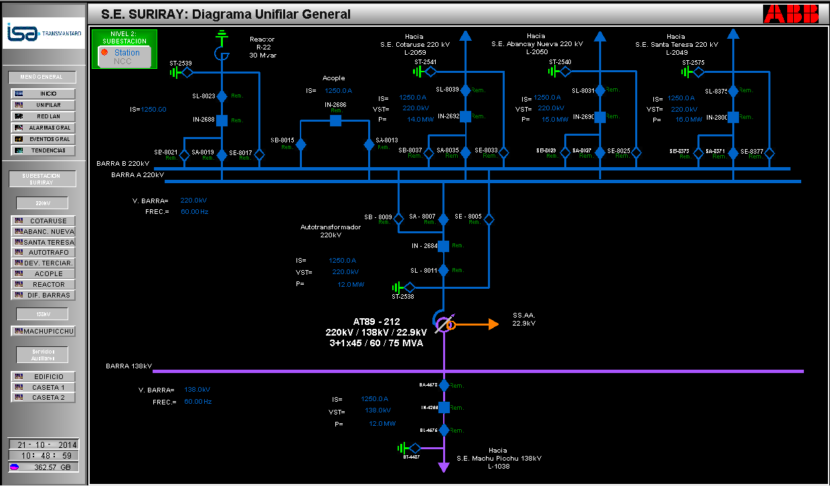
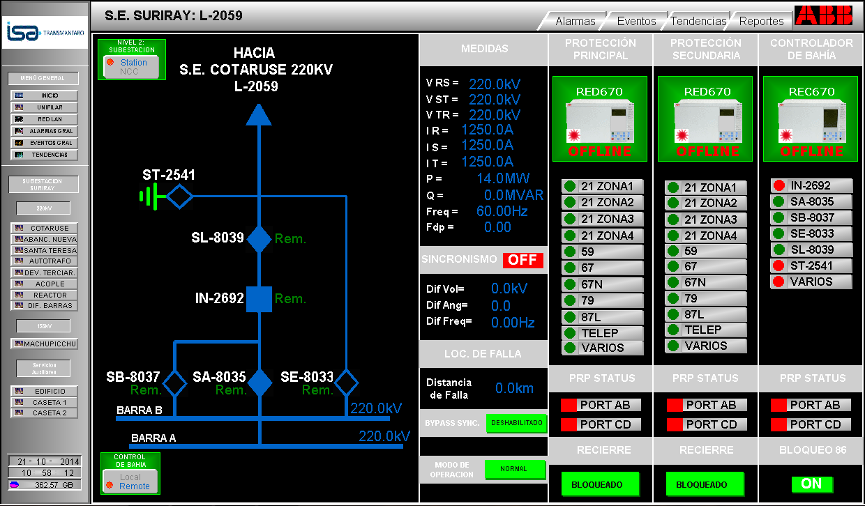
SCADA design and implementation for the Suriray Substation
By: Luis Chachayma
PROJECT OVERVIEW
SCADA monitoring systems are important to operate high voltage electric substations in generation, transmission and distribution of electric power.
The overall project was assigned to REP (Peru Energy network) and it was value in $75 Million. The project included the installation of electric substations and the transmission lines between the substations. These transmission lines connect the Machupicchu hydroelectric (renewable energy) with the national interconnected system.
The construction of the substations was done by ABB in Perú. The substations were named: SS. Machupicchu, SS. Suriray, SS. Abancay, and SS. Cotaruse.
Personally I was in charge of the automation of the SS. Suriray.
FAT (factory acceptance testing) and SAT (Site acceptance testing) were done with the client and ISA REP to approve the project.
Finally the energization of the substation was done using the SCADA receiving commands from the control center.
IMPLEMENTATION STEPS
Single line diagram was done in order to start the design of the SCADA system.
The LAN Network diagram was done to monitor the connectivity to the different equipment in the substation (protection relays, routers, switches, firewalls, power meters, PLCs).
Each equipment was integrated using industrial protocols: IEC 61850, DNP3, MODBUS.
The data collected was displayed to the local operator by interactive diagrams and menus.
Additionally the data was sent to the control center in another city(Lima) using IEC 104
Single Line Diagram of the SS. Suriray
Detailed Bay Display
Notes:
1

